Slide 1
Lead Lag Control
Control Law
Plant

Slide 2
Lead Lag Control
Adding Control and State Constraints
(no anti windup)
Control Law
Plant

Slide 3
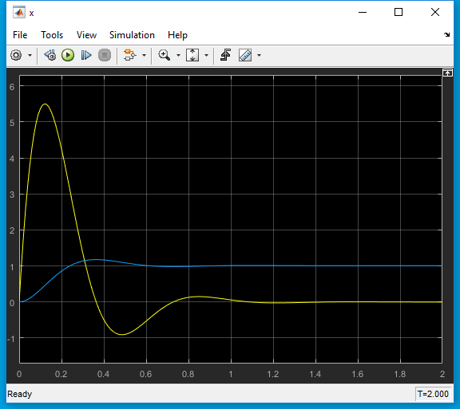
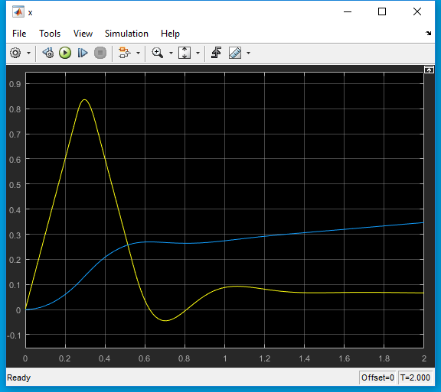
States
No Saturation
Saturation
Control Law

Slide 4
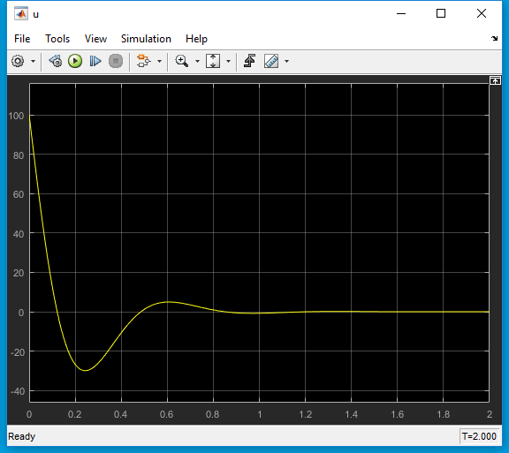
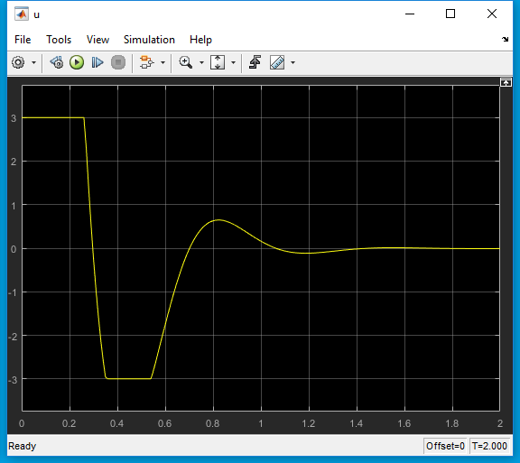
Control
No Saturation
Saturation

Slide 5
Model Predictive Control
|x1| < 1, |x2| < 1

Slide 6
Model Predictive Control
|u| < 3

